Slide 1




Infosys SpringBoard Internship 5.0
AI-Driven Supply Chain Disruption Predictor and Inventory Optimization System (Lithium-Ion Battery)
Intern Name – Neeraj Jaiswal
Email - 22bcs14137@cuchd.in
Internship duration- December 2024 – January 2025

Slide 2

Project overview
Problem Statement:
Project Objectives:
Expected Impact:
The lithium-ion battery industry faces complex supply chain challenges:
Unpredictable market fluctuations affecting. inventory management
Critical need for real-time risk assessment and monitoring.
Complex data analysis requirements for decision-making.
1. Develop an automated system for real-time supply chain monitoring.
2. Implement AI-powered risk assessment using LLaMA model.
3. Create an interactive dashboard for comprehensive supply chain management.
4. Establish automated alert systems for proactive risk management.
1. Reduced supply chain disruptions.
2. Enhanced decision-making capabilities.
3. Improved inventory management.
4. Real-time risk mitigation.

Slide 3

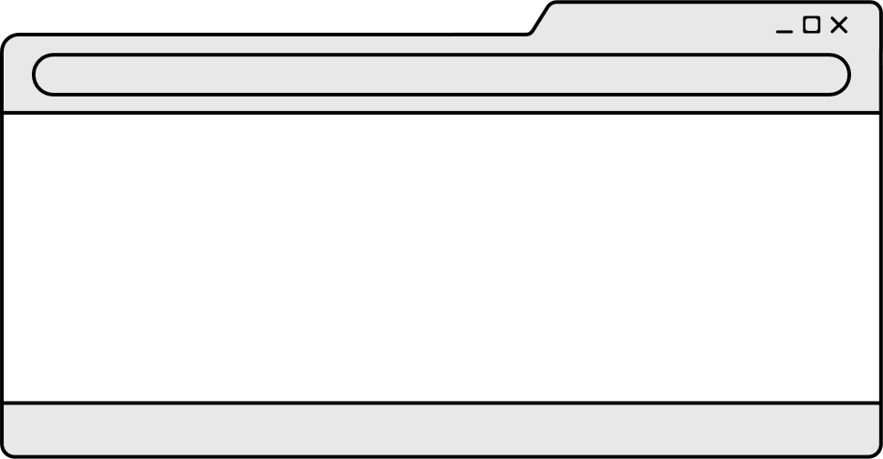
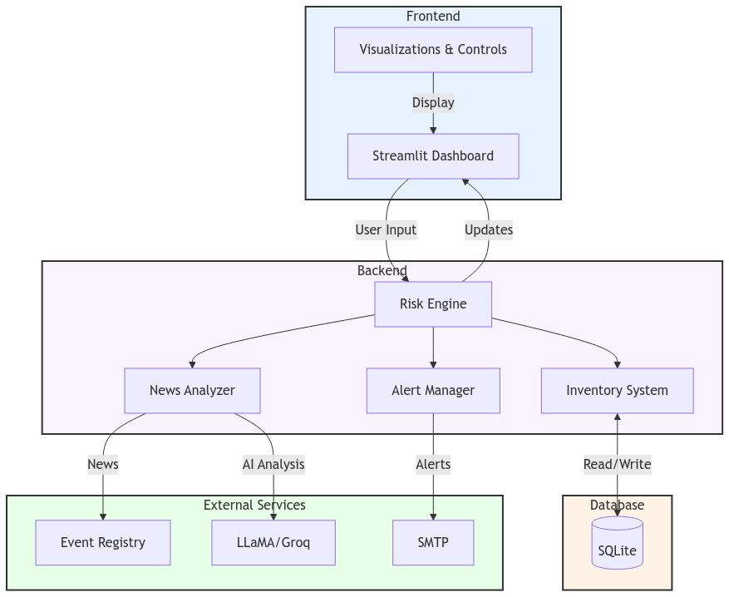
Architecture Flow-chart Diagram

Slide 4


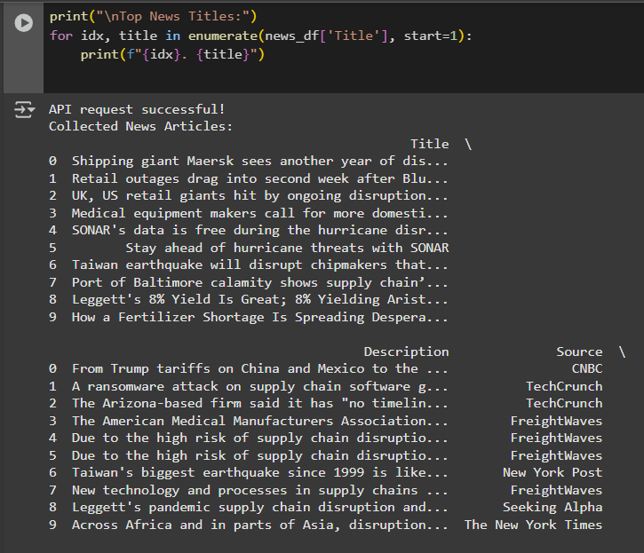
Milestone 1
Data Collection & Processing Infrastructure:
1. News Data Integration:
- Event Registry API implementation
- Real-time news fetching system
- Data preprocessing pipeline
2. Database Design:
- SQLite database schema
- Tables: inventory, damage_log, transport_delays, sales_log
- Optimized for real-time operations
3. Key Achievements:
- Successful API integration
- Efficient data storage system
- Robust error handling
- Scalable architecture

Slide 5
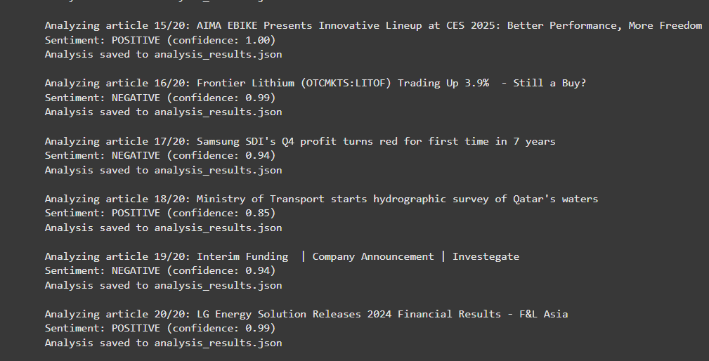



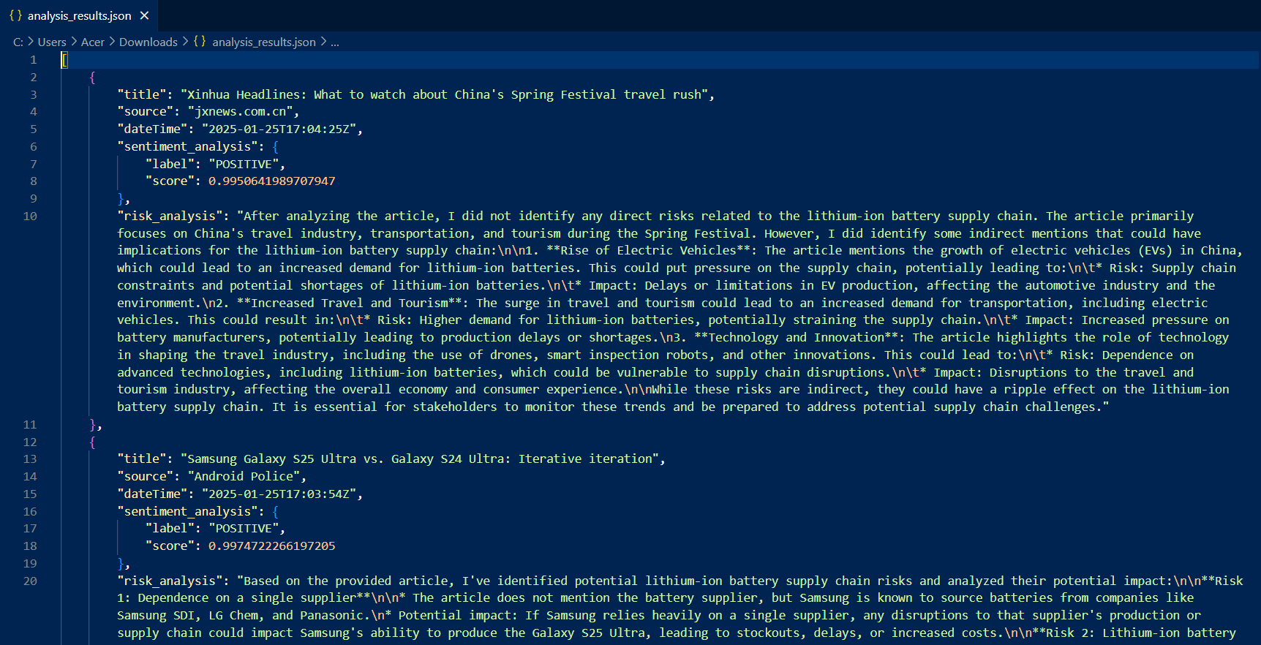
Milestone 2
LLaMA LLM Model Implementation:
1. Sentiment Analysis:
- Processing market news and events
- Scoring system: -1 to 1
- Real-time sentiment tracking
2. Risk Assessment:
- Multi-factor analysis
- Integration with inventory data
- Predictive modeling
3. Implementation Details:
- Model: LLaMA3-70b-8192
- Processing capacity: 20 articles per analysis
- Using Groq API integration for LLM Model

Slide 6

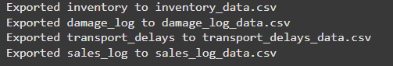
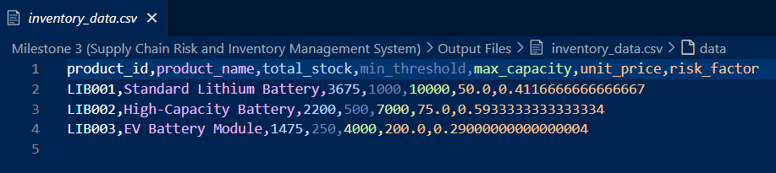
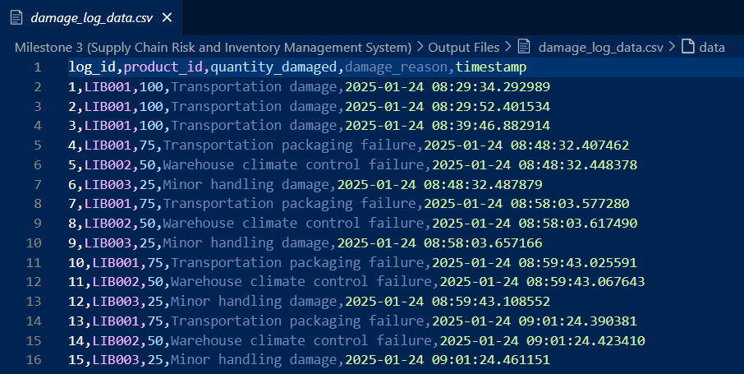
Milestone 3
Core System Development:
1. Inventory Management:
- Real-time stock tracking
- Minimum threshold monitoring
- Maximum capacity management
- Automated updates
2. Risk Assessment Algorithm:
- Stock level risk (70% weight)
- News sentiment risk (30% weight)
- Risk scale: 1-10
- Automated risk factor calculation
3. Logging Systems:
- Damage tracking
- Transport delays
- Sales monitoring
- Historical data analysis

Slide 7
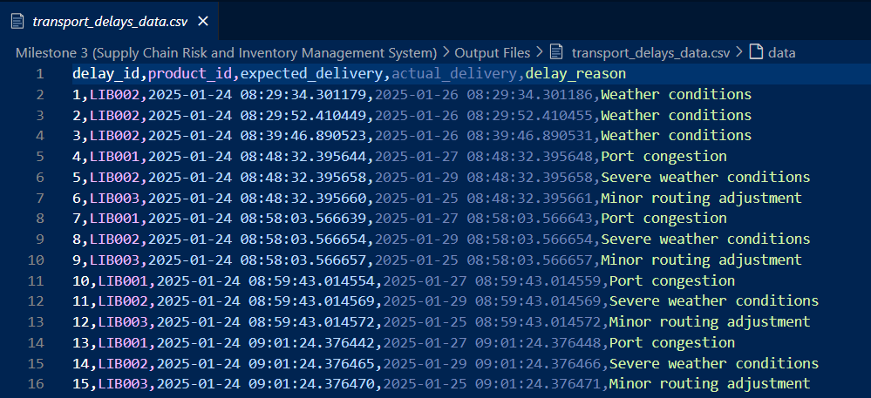
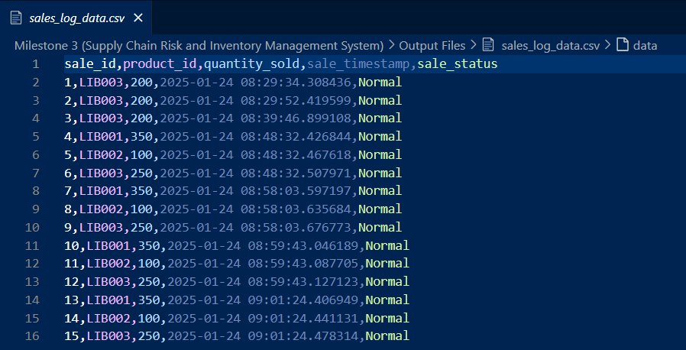

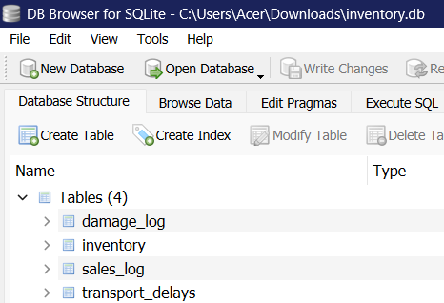
Milestone 3 Continued

Slide 8

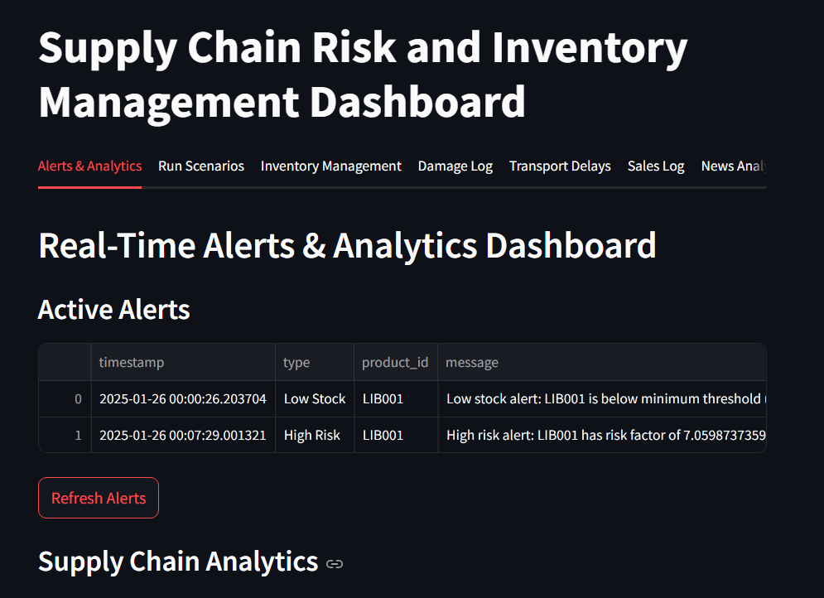
Milestone 4
1. Real-Time Alerts & Analytics Dashboard:
Live Monitoring: Real-time tracking of inventory levels, risk factors, and supply chain events
Email Notifications: Automated alerts for:
Low stock conditions (when inventory falls below minimum threshold)
High risk situations (when risk factor exceeds)
Visual Analytics: Interactive bar charts comparing current stock vs. minimum thresholds Risk factor gauge charts with color-coded risk levels Historical damage distribution pie charts Transport delay analysis graphs
Active Alerts

Slide 9
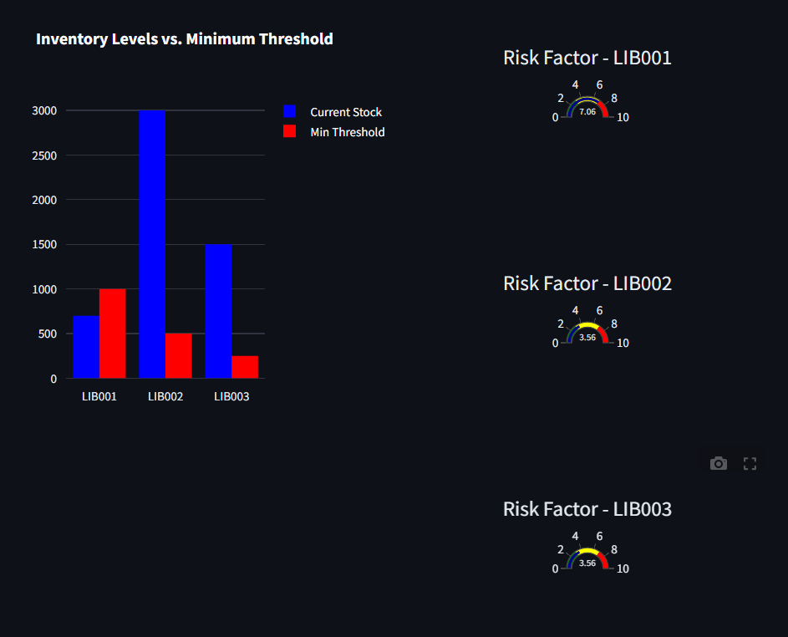
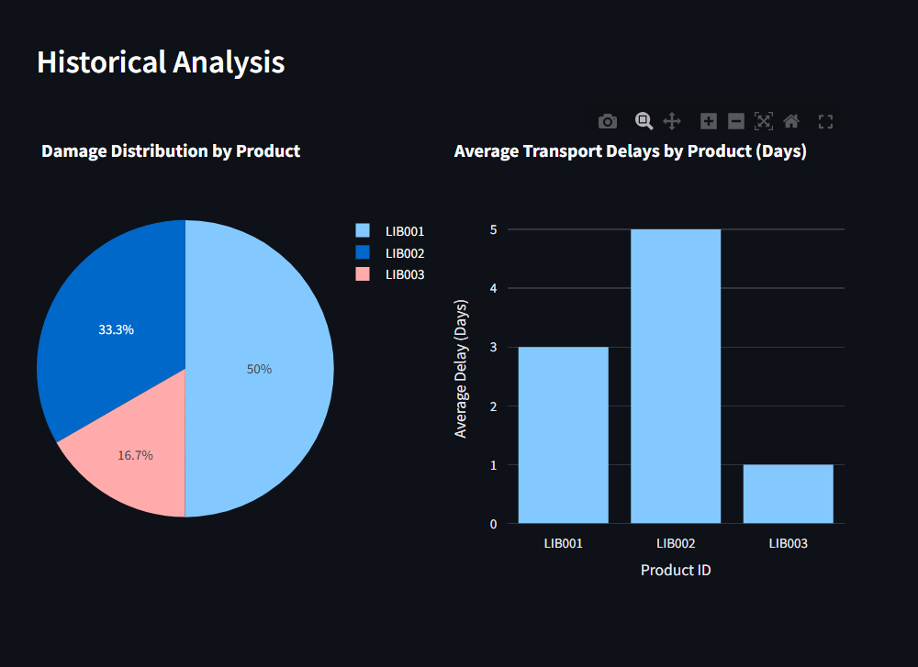
Milestone 4 Continued
Real-time Inventory Level and Risk Factor Tracking Dashboard
Visual representation of Damage and Transport Delays by Product

Slide 10
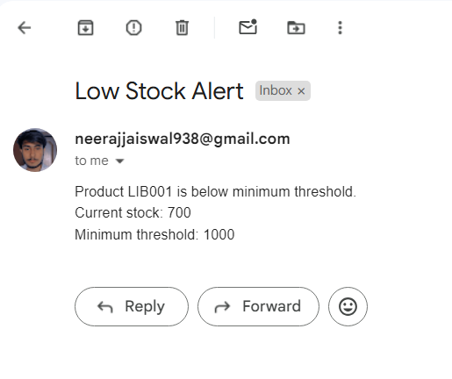
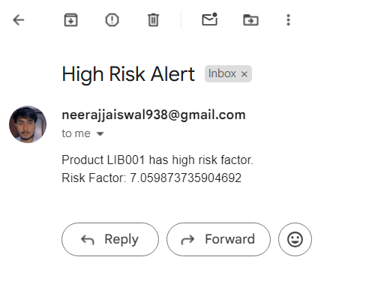
Milestone 4 Continued
Automated Low Stock Email Alert
Automated High Risk Email Alert

Slide 11
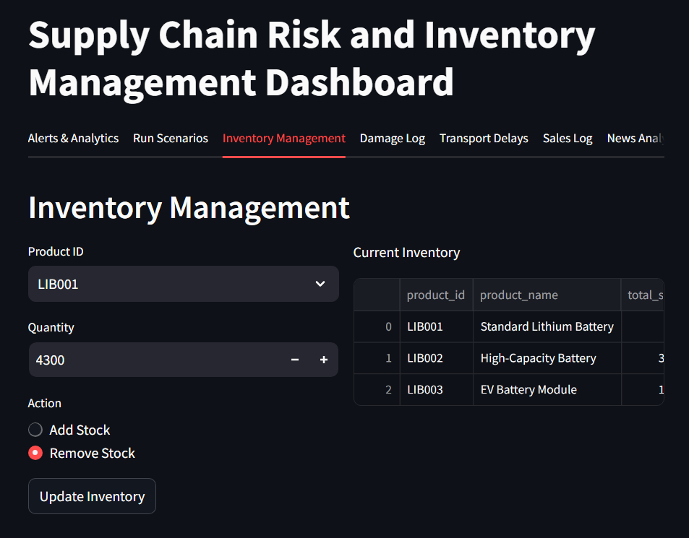

Milestone 4 continued
2. Inventory Management:
Track multiple battery products (LIB001, LIB002, LIB003).
Real-time stock updates.
Add or remove products.
Downloadable Inventory Table in CSV format.
Automated risk factor calculations
3. Comprehensive Logging System:
Damage Log: Track product damages with reasons
Transport Delays: Monitor shipping delays and reasons
Sales Log: Record and track sales transactions
Add or remove logs and delay data with reason included and even downloadable tables in CSV format.
Inventory Management Dashboard

Slide 12
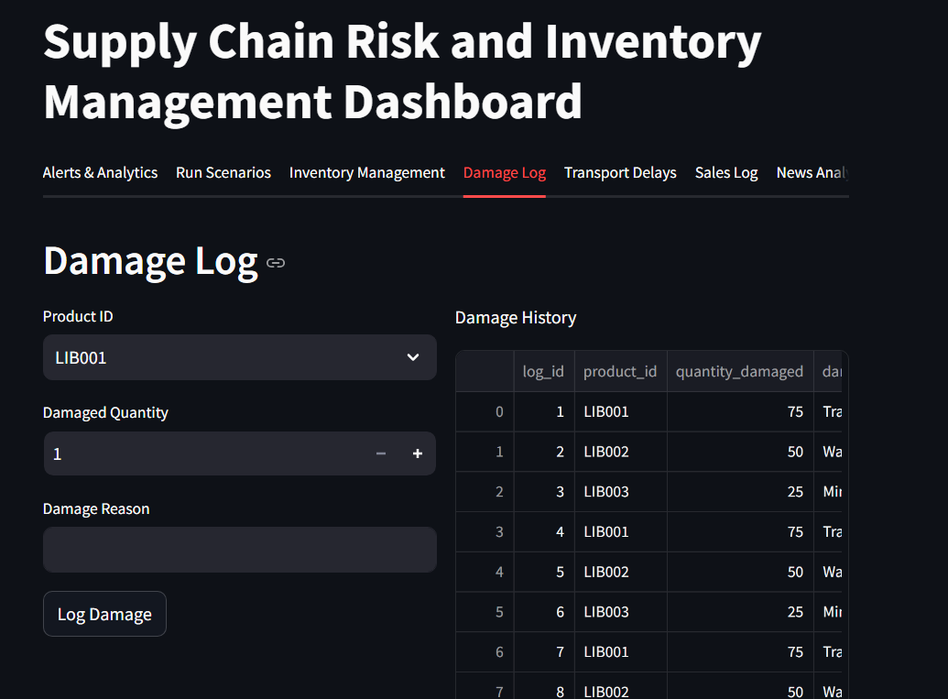
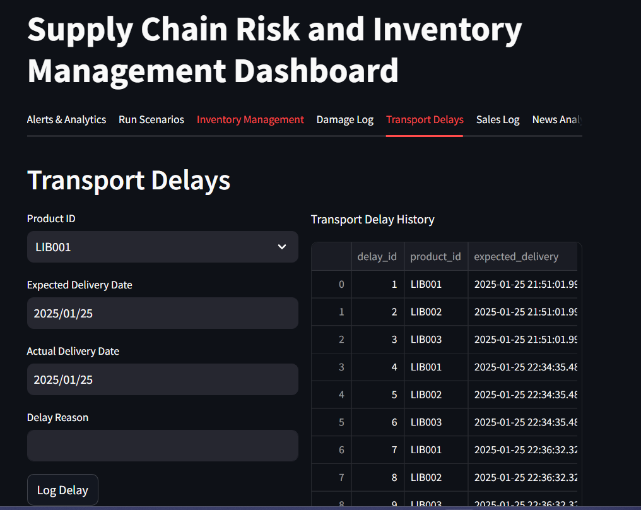
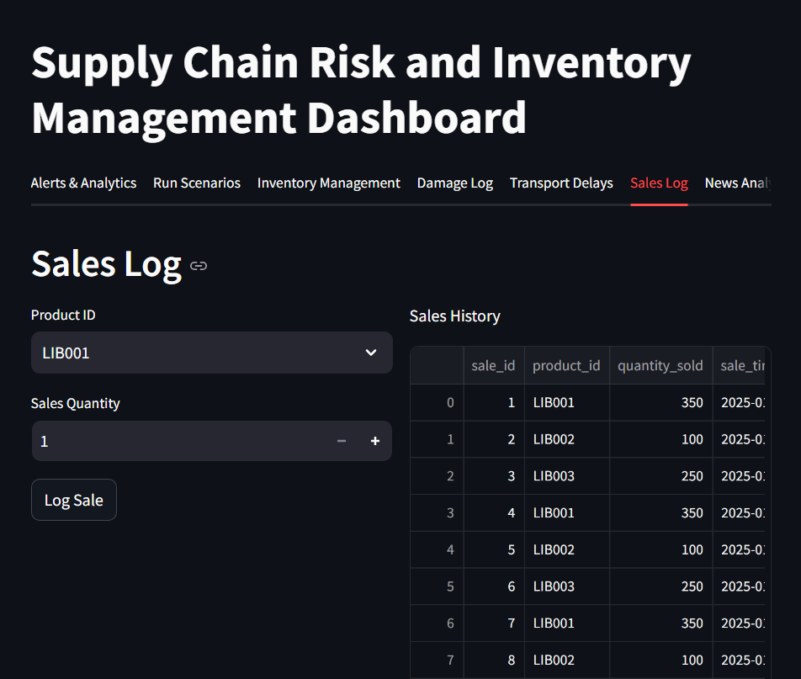
Milestone 4 Continued
Damage logs Dashboard
Transport Delays Dashboard
Sales Logs Dashboard

Slide 13

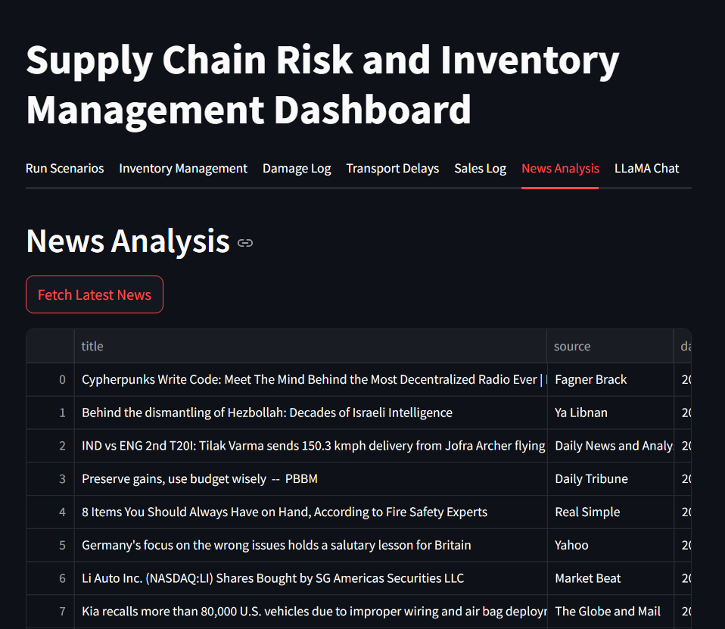
Milestone 4 continued
2. News Analysis and Sentiment Tracking:
Real-time news fetching and analysis.
Sentiment analysis of news articles.
Risk analysis using LLaMA model.
Downloadable JSON reports.
Automatic risk factor updates based on news sentiment.
3. AI powered Chat Interface:
Interactive chat with LLaMA model.
Context-aware responses incorporating having knowledge of current inventory status, recent news analysis, Historical data.
Natural language queries about inventory and risks.
News Analysis Dashboard

Slide 14

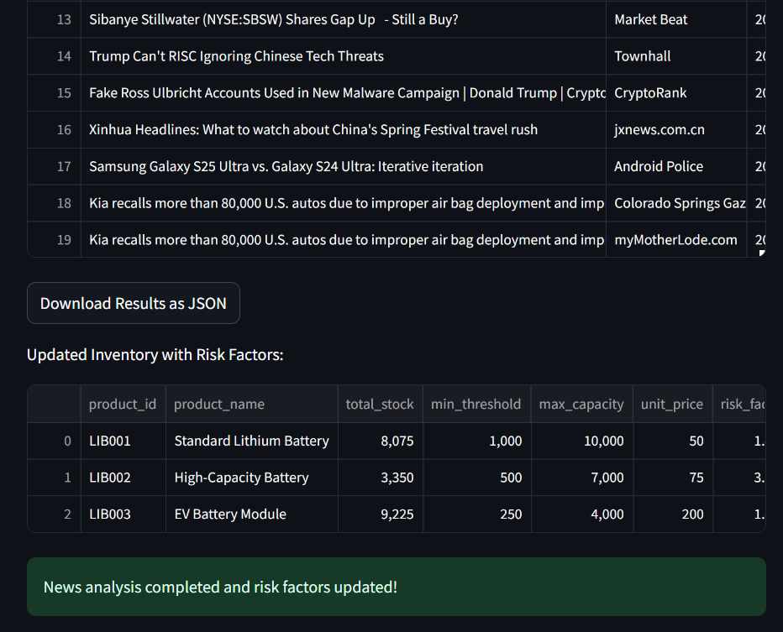
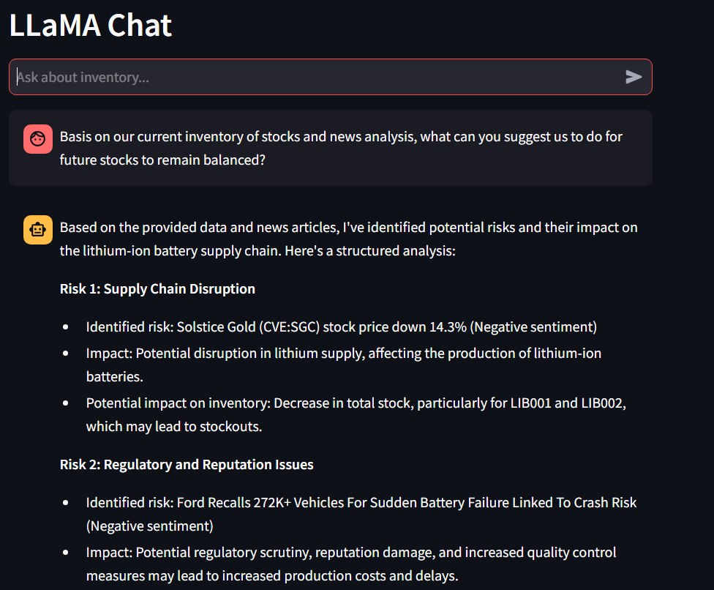
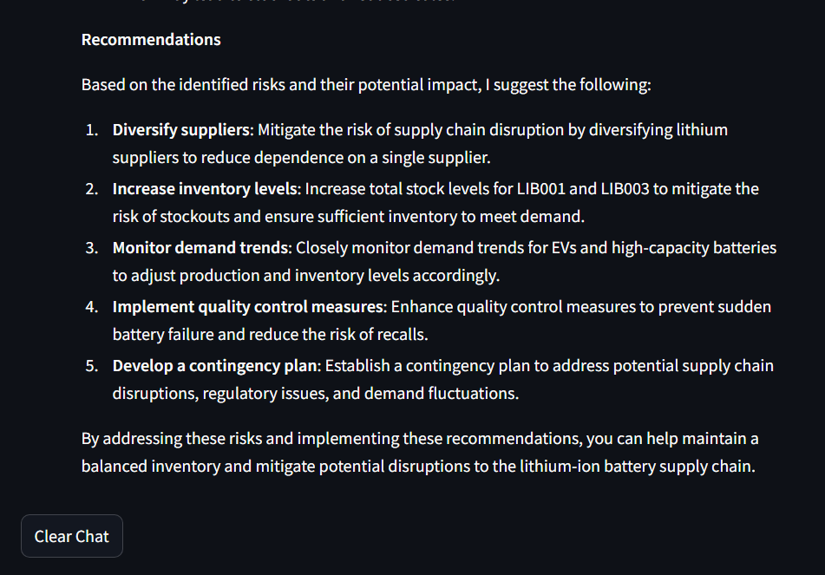
Milestone 4 Continued
News analysis done and risk factors updated
LLaMA Chat with full context awareness
Clear Chat option and Model recommendation for current inventory

Slide 15
Milestone 4 continued
2. Inventory Management:
Track multiple battery products (LIB001, LIB002, LIB003).
Real-time stock updates.
Add or remove products.
Downloadable Inventory Table in CSV format.
Automated risk factor calculations
3. Comprehensive Logging System:
Damage Log: Track product damages with reasons
Transport Delays: Monitor shipping delays and reasons
Sales Log: Record and track sales transactions
Add or remove logs and delay data with reason included and even downloadable tables in CSV format.
Inventory Management Dashboard

Slide 16
Conclusion
The AI-Powered Supply Chain Risk Management System represents a significant advancement in supply chain management for the lithium-ion battery industry. Through the integration of real-time monitoring, AI-driven analysis, and automated risk assessment, the system successfully addresses critical challenges in supply chain management. Key achievements include:
1. Development of a comprehensive risk assessment framework combining inventory metrics and market sentiment
2. Implementation of real-time monitoring with automated email alerts for critical situations
3. Integration of LLaMA model for advanced news analysis and risk prediction
4. Creation of an intuitive Streamlit dashboard for effective visualization and control
5. Establishment of a robust database system for efficient data management and historical analysis
The project demonstrates the potential of AI and automation in transforming traditional supply chain management into a proactive, data-driven decision-making process.

Slide 17

Future scope
1. MERN Stack Migration:
• React Frontend:
- Interactive dashboards.
- Mobile-responsive design.
- Role-based user interfaces.
• Node.js & Express Backend:
- RESTful API architecture.
- Real-time WebSocket updates.
- Robust authentication system.
• MongoDB Database:
- Improved scalability.
- Enhanced data aggregation.
- Real-time data handling.
2. AI and Analytics Enhancement:
• Advanced Predictive Models:
- Demand forecasting
- Automated inventory optimization
- Pattern recognition
• Enhanced NLP Capabilities:
- Multilingual support
- Advanced risk analysis
3. Mobile and Integration:
• Mobile App Development:
- Cross-platform application
- Push notifications
• Third-party Integrations:
- ERP systems
- IoT devices
- Industry APIs
4. Security and Compliance:
• Enhanced Security:
- Multi-factor authentication
- End-to-end encryption
• Regulatory Compliance:
- GDPR and industry standards
- Data privacy protocols

Slide 18

The end

